Slide 1
SweetSep™ Columns
New generation of HPAEC columns for all classes
of carbohydrates

Slide 2
Outlook
New resin for HPAEC
Efficiency SweetSep™ columns
Universal chemistries
Comparison CarboPack™ vs. SweetSep™
Advantages of 2.1 mm ID columns
High resolution 30 cm columns
Conclusions

Slide 3
New resin for HPAEC
5 μm non-porous poly(DVB-co-EVB) resin particle
latex particles (white) with quaternary amine AEX groups
SEM picture of the latex agglomerated particles (1000 nm scale bar)
SEM of monodisperse resin particles

Slide 4
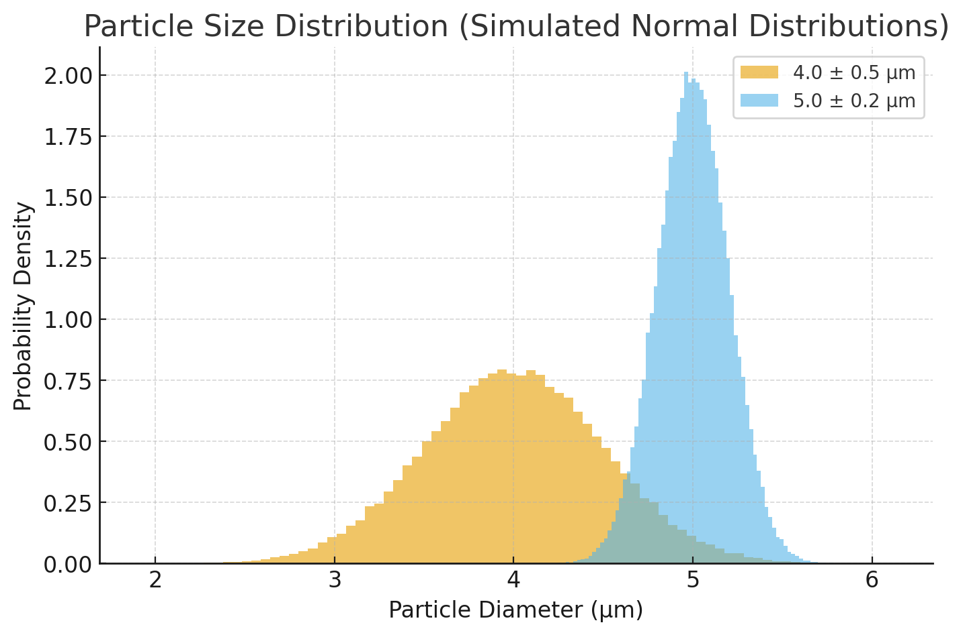
Particle size distribution
Mono- vs. polydisperse
Based on normal distribution
CarboPack™
SweetSep™
4

Slide 5
Column performance data
No. | Compound Name | Reten. Time [min] | W05 [min] | Capacity [-] | Efficiency p/column | Eff/l [t.p./m] | Resolution [-] | Symmetry/ Tailing [-] | HETP [µm] | h
1 | Fucose | 2.282 | 0.101 | 0.666 | 13290 | 66.400 | - | 1.1 | 15.0 | 3.0
2 | Arabinose | 2.992 | 0.114 | 1.184 | 17676 | 88.400 | 8.4 | 1.1 | 11.3 | 2.3
3 | Galactose | 3.353 | 0.133 | 1.447 | 16208 | 81.000 | 3.7 | 1.1 | 12.3 | 2.5
4 | Glucose | 3.514 | 0.136 | 1.565 | 17407 | 87.000 | 1.5 | 1.0 | 11.5 | 2.3
5 | Fructose | 4.000 | 0.145 | 1.920 | 20100 | 100,500 | 4.4 | 1.1 | 10.3 | 2.0
6 | Sucrose | 4.315 | 0.159 | 2.150 | 18600 | 93.000 | 2.6 | 1.0 | 10.8 | 2.2
7 | Allolactose | 5.594 | 0.203 | 3.083 | 19155 | 95.800 | 8.9 | 1.0 | 10.4 | 2.1
8 | Lactose | 5.882 |  | 3.293 | 17697 | 88.500 | 1.7 | 1.0 | 11.3 | 2.3
9 | Lactulose | 6.121 |  | 3.468 | 18917 | 94.600 | 1.4 | 1.1 | 10.6 | 2.1
10 | Epilactose | 6.55 | 0.235 | 3.781 | 20560 | 102.800 | 2.4 | 1.0 | 10.2 | 1.9
11 | Raffinose | 6.904 | 0.262 | 4.039 | 17546 | 87.800 | 1.8 | 1.0 | 11.4 | 2.3
≈ 20.000 plates / column (20 cm, 5 µm)
5
Notes:
Add reduced plate height (2.0 is theoretical minimum for 5 micron particles)

Slide 6
Available chemistries
AEX18 Fluorodeoxyglucose, [¹⁸F]FDG, according EP & USP methods. The 4 × 200 mm is registered under the USP column code L46.
AEX20 Fast, high-resolution separation of monosaccharides from food samples and biomass, including monosaccharides and sialic acids from glycoproteins.
AEX200 Universal column for separation of mono- to polysac- charides in F&B, artificial sweeteners, plants, glycans.
6
Notes:
Add reduced plate height (2.0 is theoretical minimum for 5 micron particles)

Slide 7
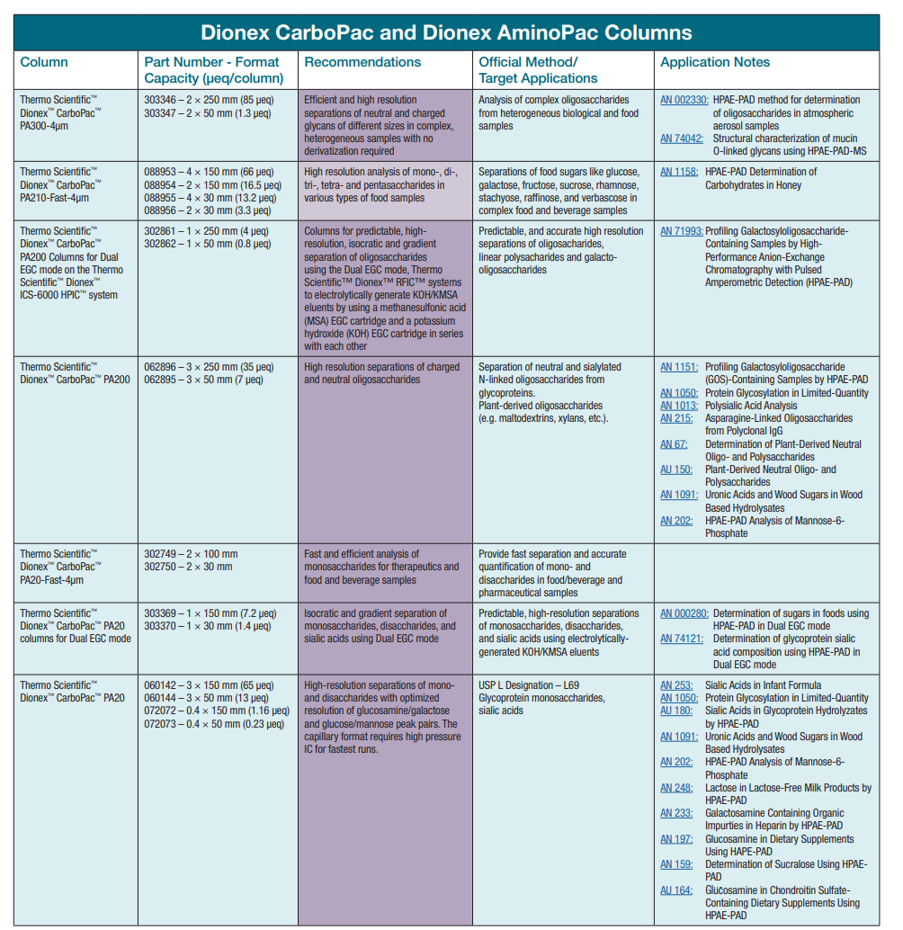

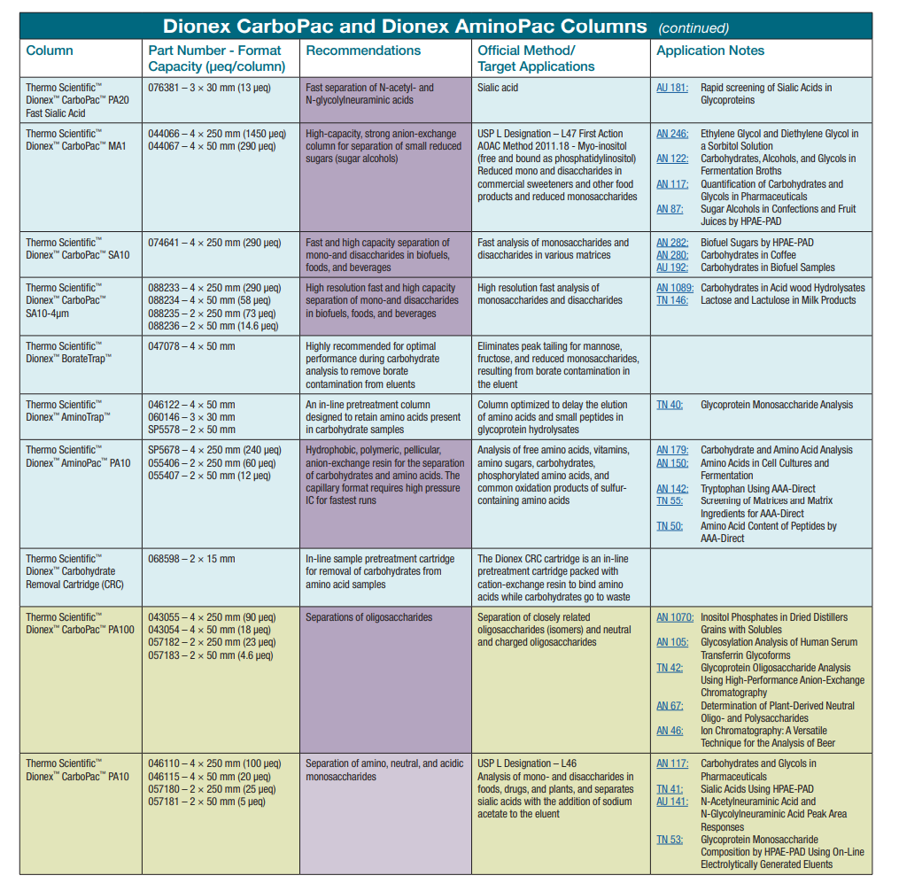
Column selection guide
Thermo: PA 10, 20, 200, 210, 300, MA1, SA10 = need 7 chemistries
Antec: AEX 18, 20 and 200 = only 3 chemistries needed for most separations
7

Slide 8
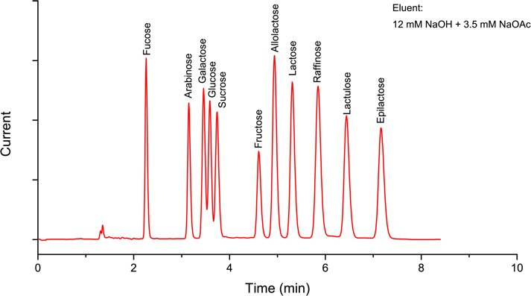
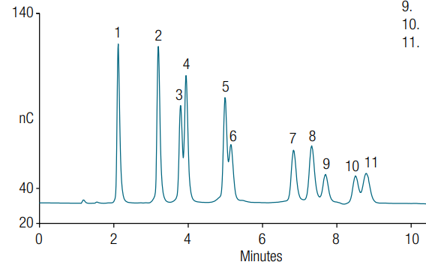
Separation of lactose and isomers
Antec Scientific
Thermo Scientific
SweetSep™ AEX200
CarboPack™ PA200
8

Slide 9
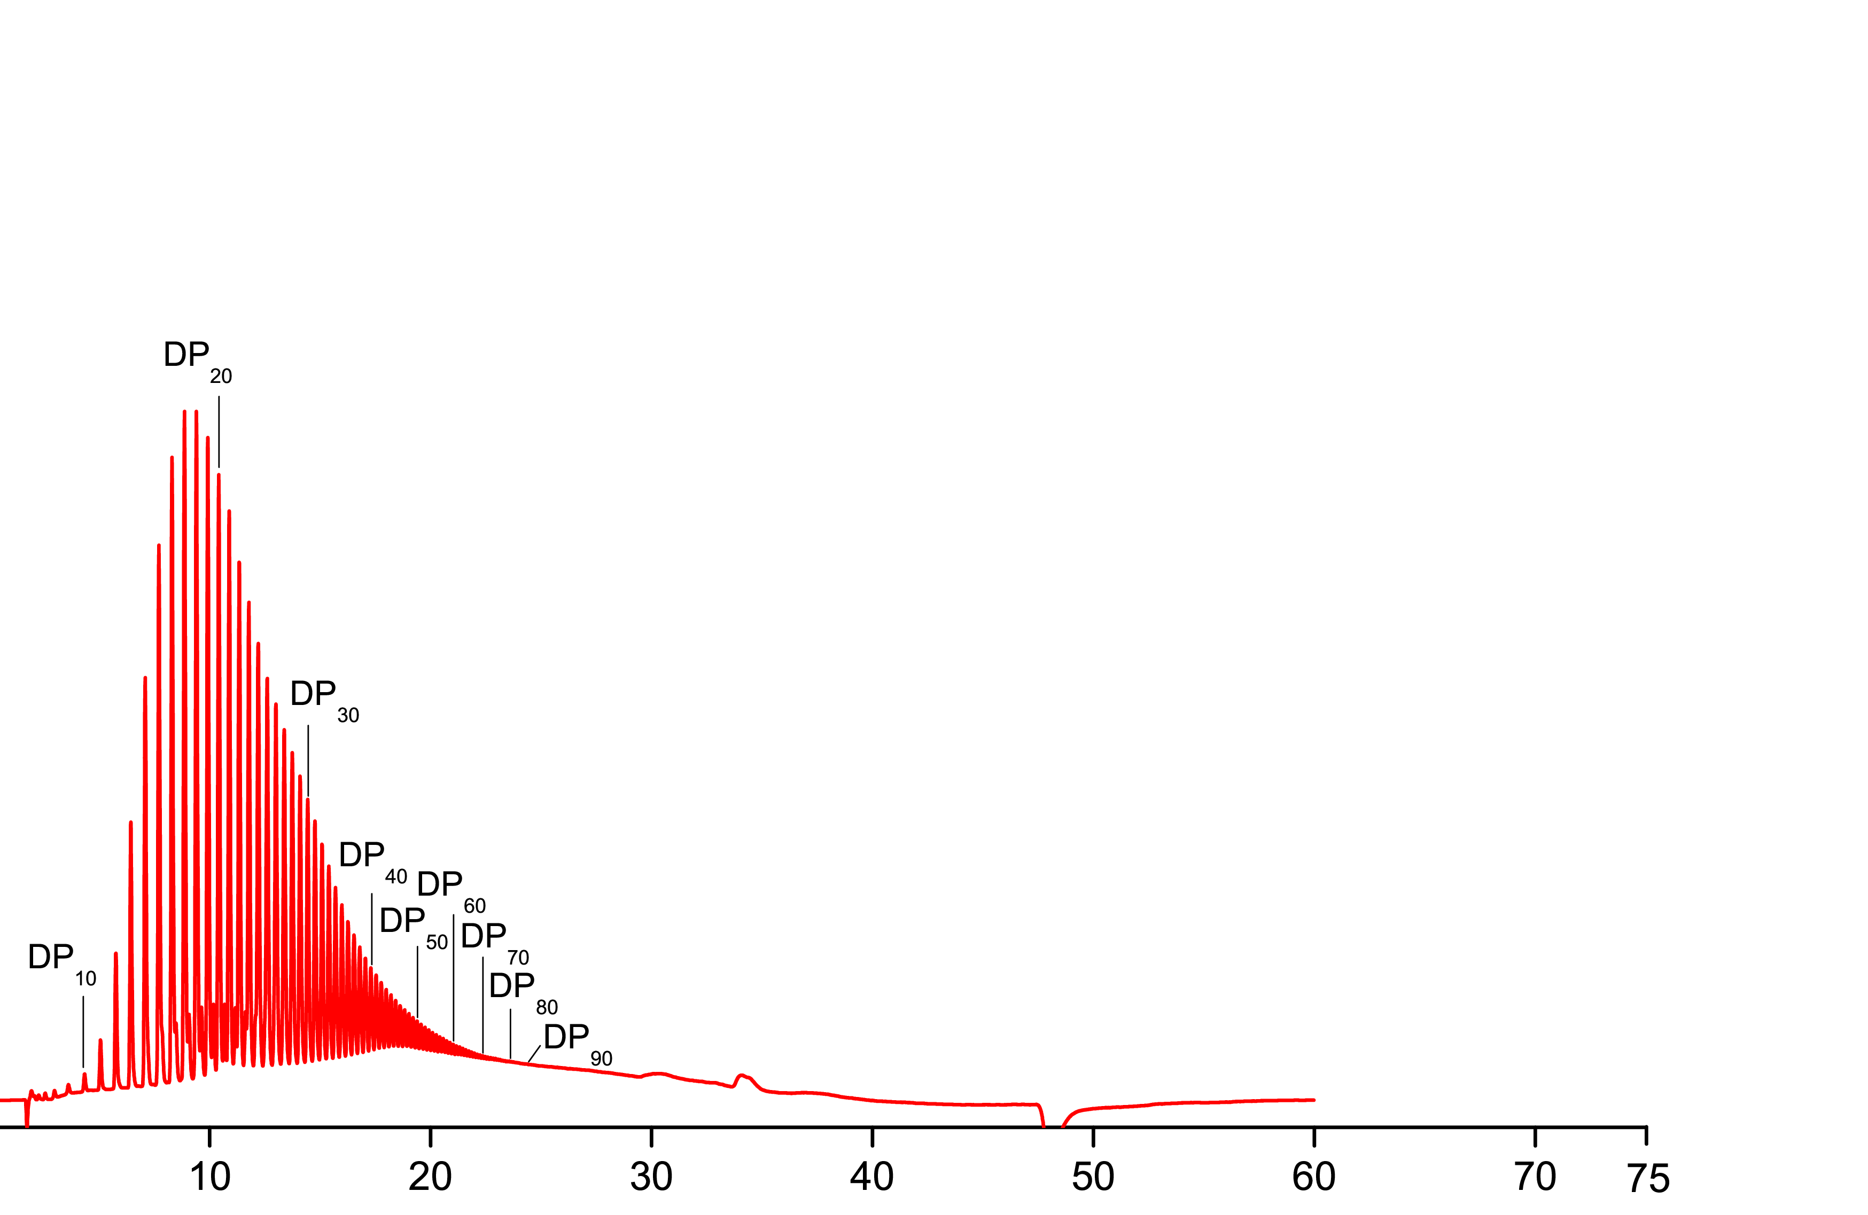
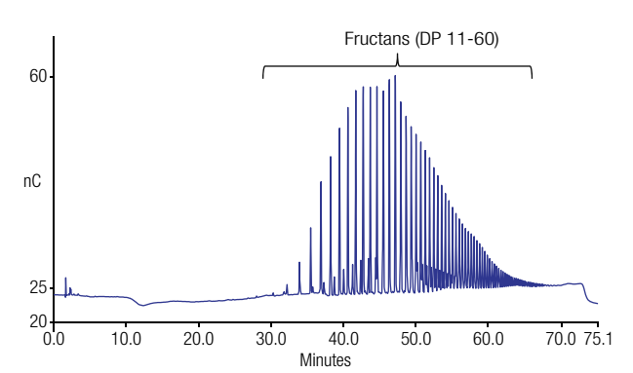
Separation of fructans
Antec Scientific
Fructans (DP 10 – 90)
Thermo Scientific
500 nA
60
Current
40 nC
0
min
SweetSep™ AEX200 CarboPack™ PA200

Slide 10
Fructans – with NaNO₃ as pushing ion
Gradient Conditions
Time (min) | Mobile phase | Description
0 | 100 mM NaOH + 25 mM NaNO₃ | gradient elution
30 | 100 mM NaOH + 200 mM NaNO₃
30-45 | 100 mM NaOH + 200 mM NaNO₃ | Column clean-up
45-60 | 100 mM NaOH + 25 mM NaNO₃ | Equilibration
1.5
DP
20
1.0
SweetSep AEX200
35°C Separation, 45°C Detection
A)
DP
80
μ
Current (
DP
30
DP
90
0.5
DP
40
DP
50
DP
DP
DP
60
DP
70
80
10
DP
90
0.0
0
5
10
15
20
25
30
Time (min)

Slide 11
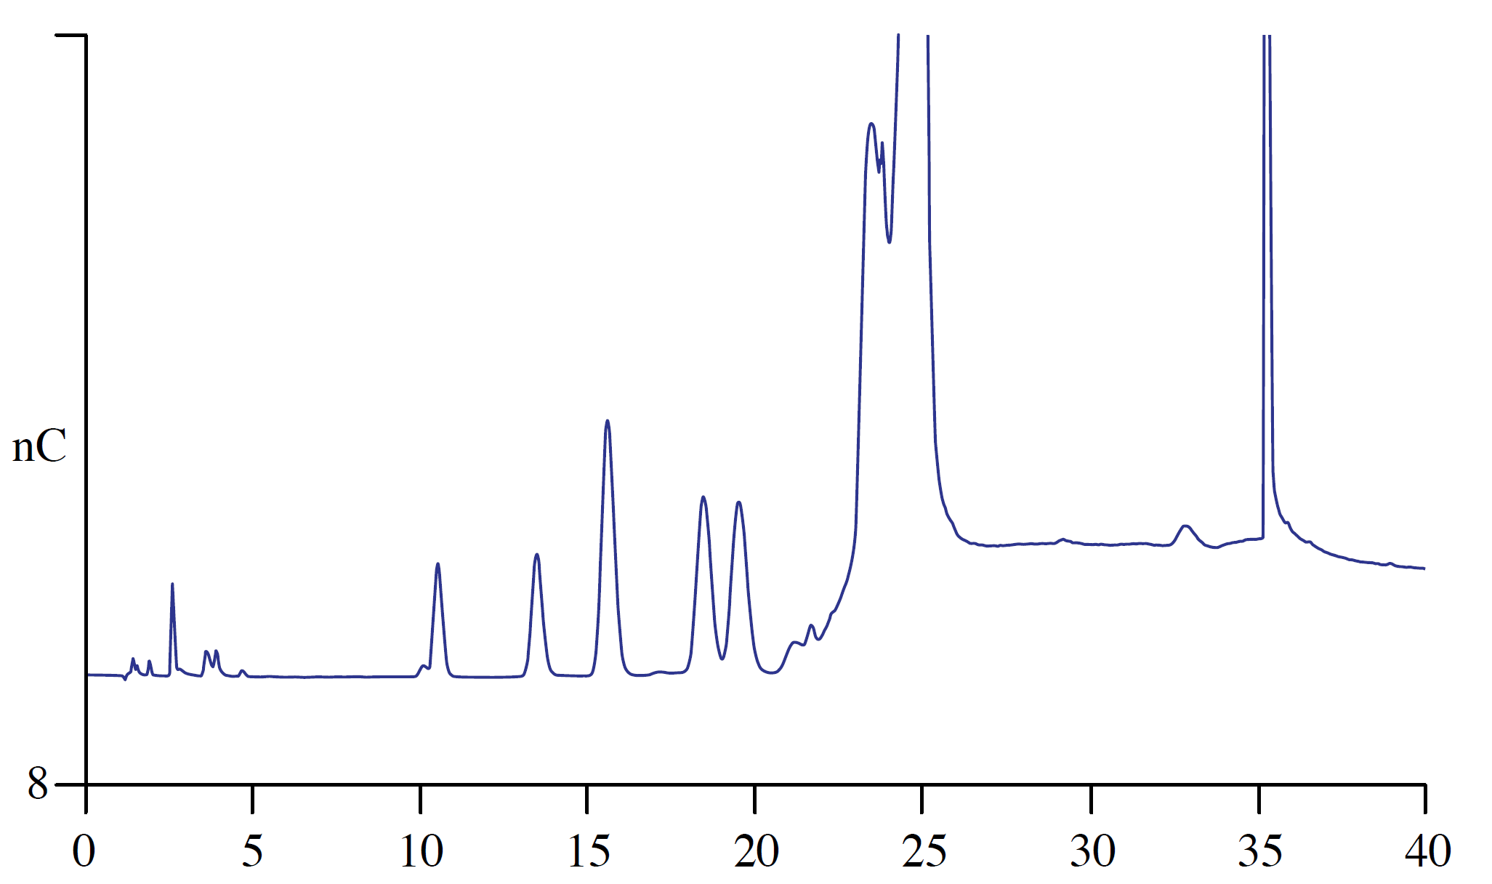
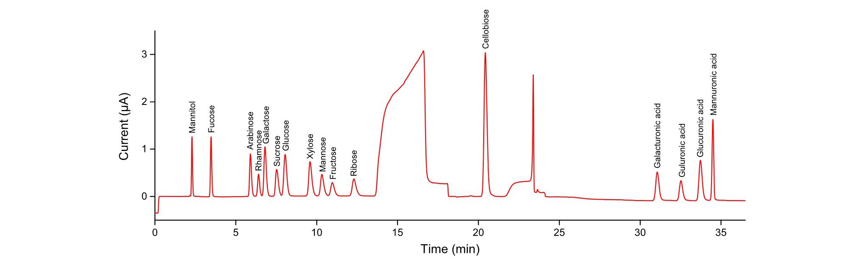
Carbohydrates from biomass hydrolysates
60
nC
8
Thermo Scientific
CarboPack™ PA20
7,6
8
9
4,3
5
10
2
0 5 10 15 20 min
Mannitol
Fucose
Arabinose
Rhamnose
Galactose
Sucrose
Glucose
Xylose
Mannose
Fructose
Ribose
1
2
5
Antec Scientific
SweetSep™ AEX20
1.0
0
3
7
8
Current
6
4
9
10
11
0 5 10 min

Slide 12
N-Glycans using HPAEC-PAD/MS
13 most commonly observed N-glycans on therapeutic monoclonal antibodies (NIST SRM3655)

Slide 13
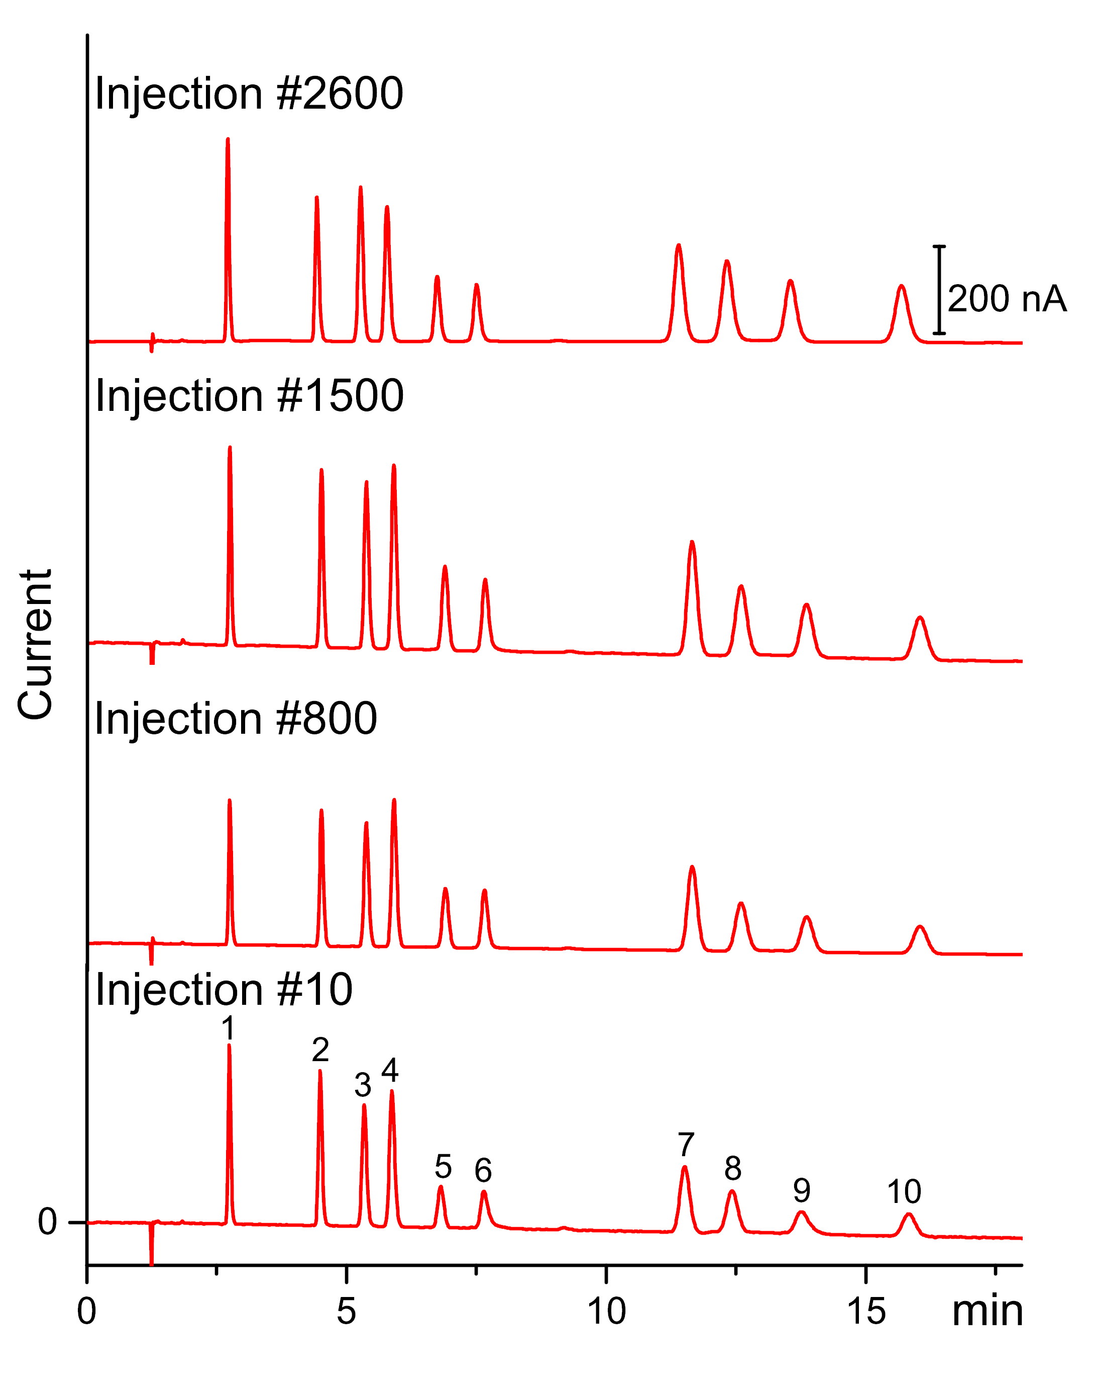
Column stability/lifetime
Fucose
Arabinose
Galactose
Glucose
Sucrose
Fructose
Allolactose
Lactose
Lactulose
Epilactose
13

Slide 14
Advantages of 2.1 mm ID columns
Comparison 2.1 vs. 4.0 mm ID SweetSep™ columns

Slide 15
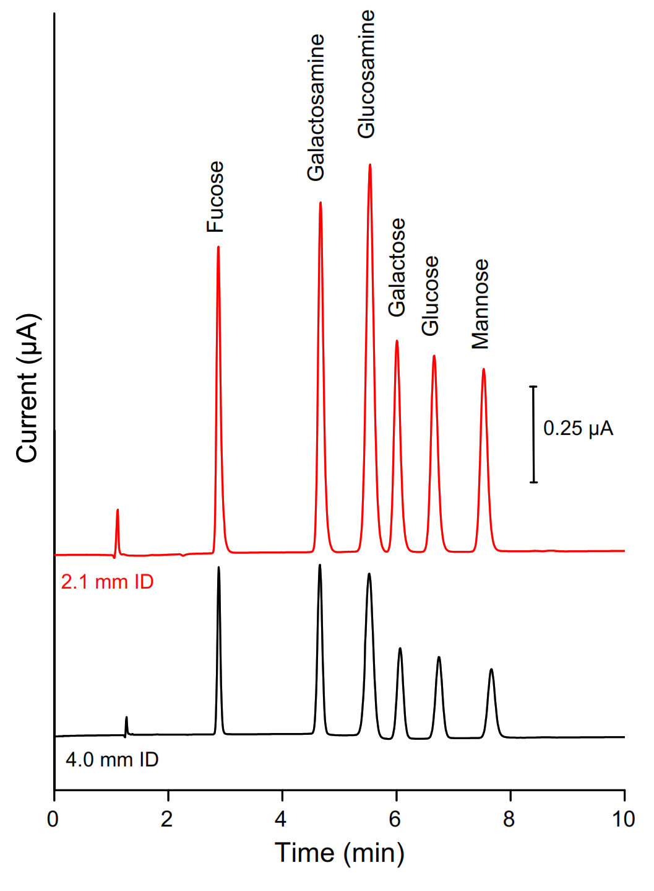
2.1 vs. 4.0 mm ID SweetSepTM columns
Advantages of 2.1 mm ID columns
Up to 3x higher sensitivity
4x reduction in mobile phase consumption
No loss in separation efficiency when using the same injection volume
10 µL injection of a 10 µM mix of monosaccharides
on a 2.1 (red) and 4.0 x 200 mm, AEX20 column (black)

Slide 16
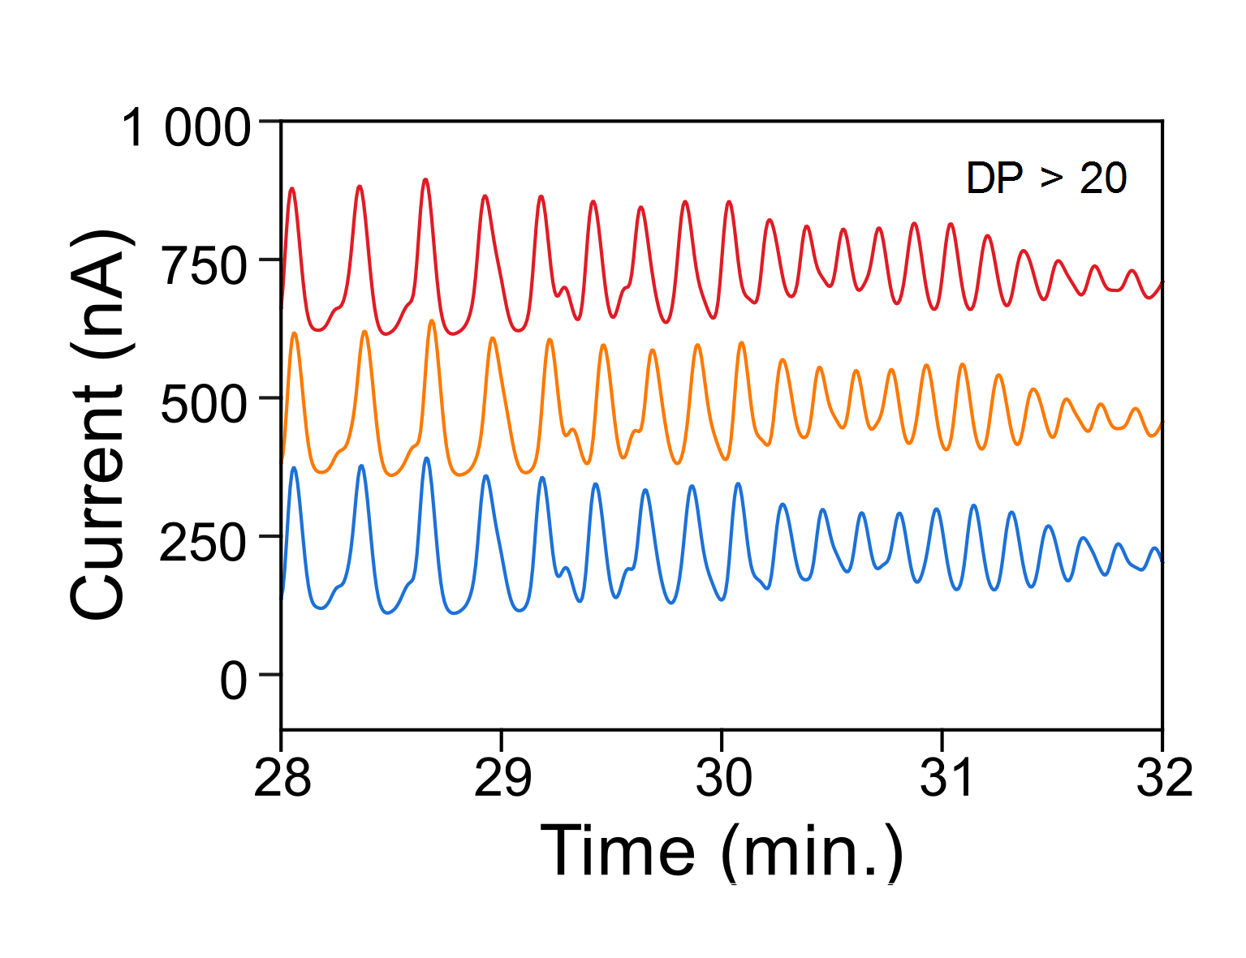
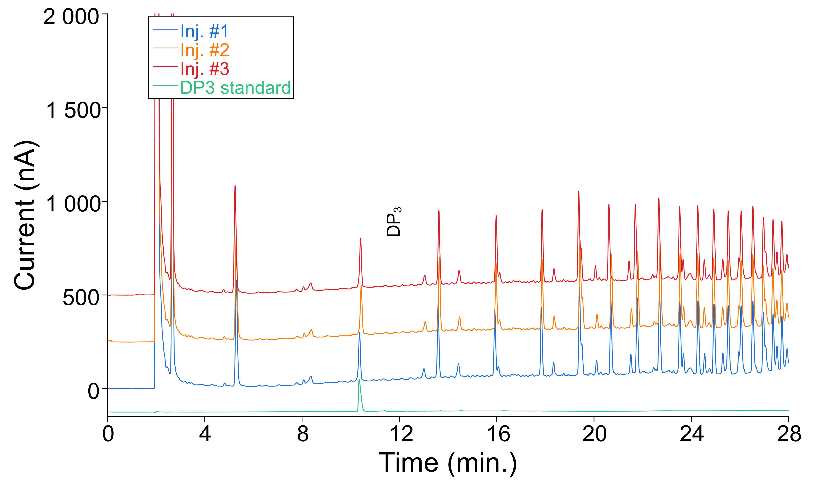
Pectin oligosaccharides
2.1 mm x 20 cm SweetSep™ + 2.1 mm x 5 cm pre-column
DP > 20
Zoom 2x
………
………
………

Slide 17
Advantages & savings 2.1 mm ID columns
 | 4 mm × 200 mm | 2.1 mm × 200 mm
Flow | 0.8 mL/min | 0.18 mL/min
Injection vol | 10 µL | 3 µL
Sensitivity | 1 | 3 (10µL)
4 Liter of eluent | 3.5 days | 15.4 days
30 min run time | 170 inj. (samples) | 740 inj. (samples)
Liters of eluent / 365 days | 417 L | 95 L
Savings on eluent |  | 77%

Slide 18
30 cm High resolution SweetSep™ columns
Comparison 20 vs. 30 cm columns
for complex sample analysis

Slide 19
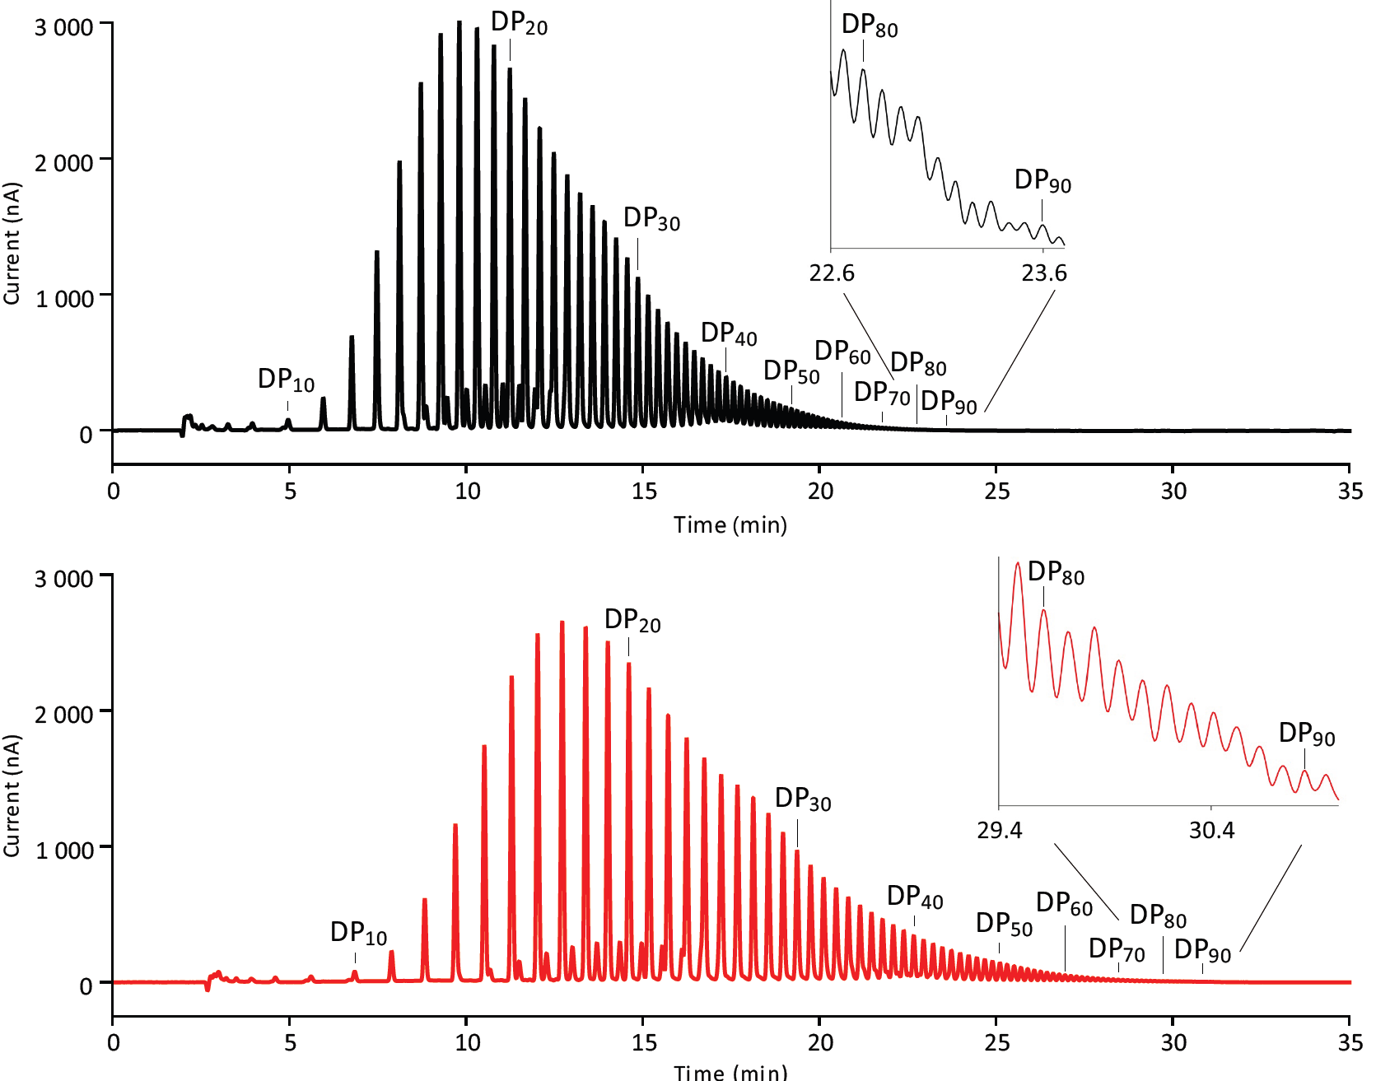
Fructans
20 cm
30 cm

Slide 20
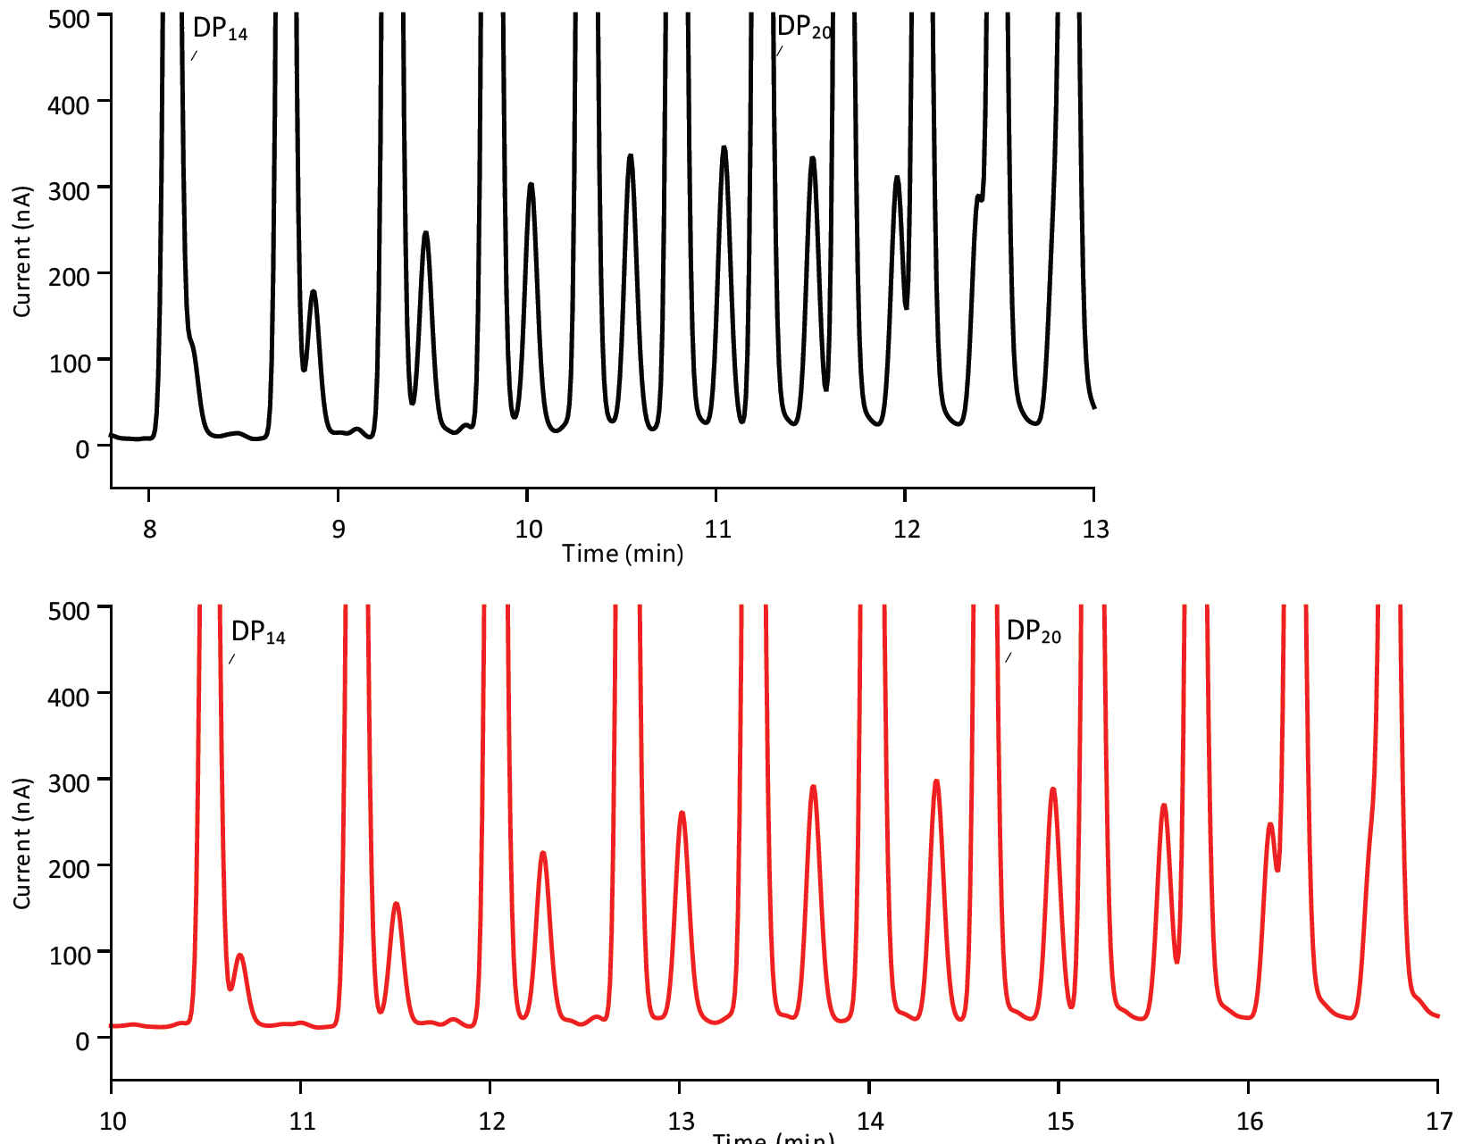
Fructans
20 cm
30 cm

Slide 21
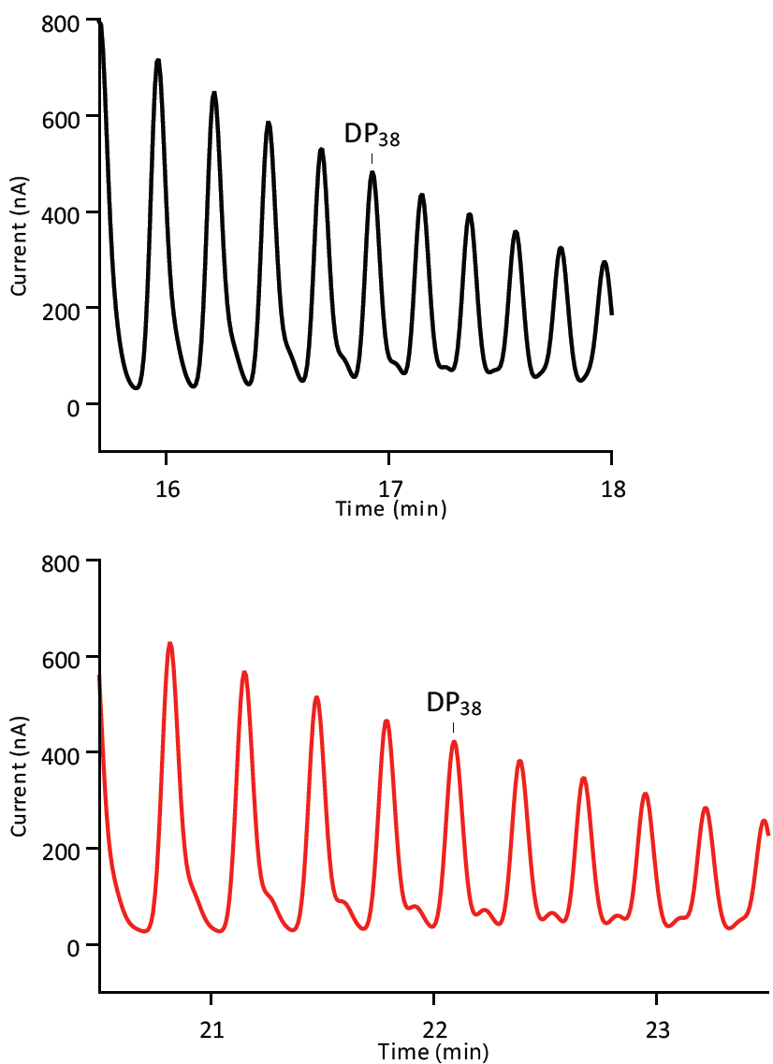
Fructans
20 cm
30 cm

Slide 22

Resources: SweetSep™ brochure
https://antecscientific.com/products/instruments/sweetsep-column-brochure/

Slide 23
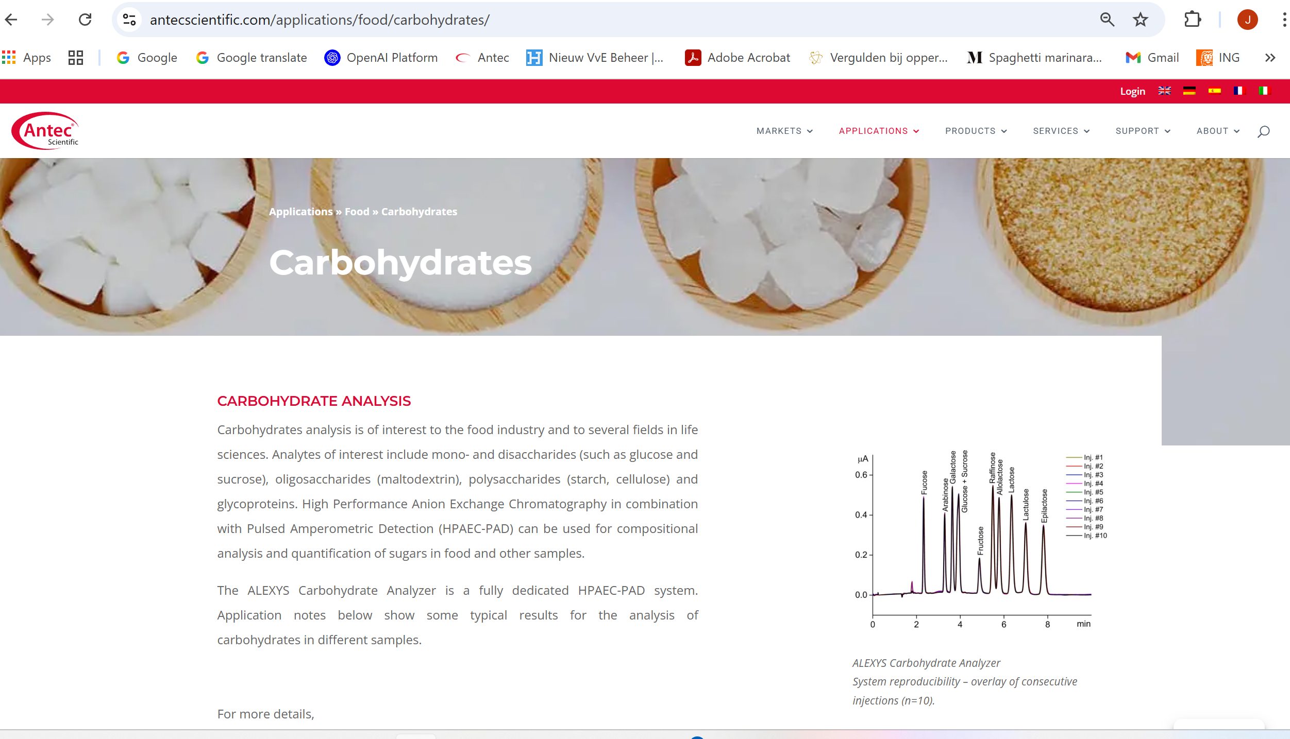
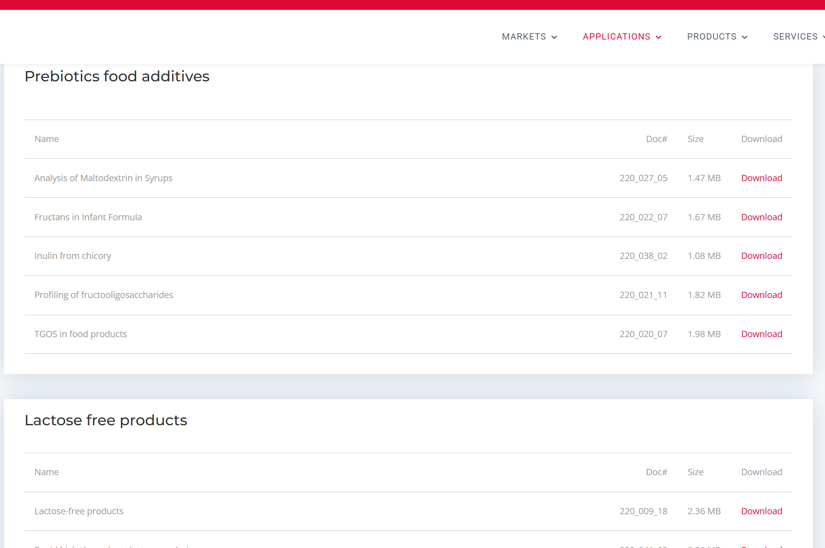
Resources: > 35 application notes
https://antecscientific.com/applications/food/carbohydrates/

Slide 24





Conclusions SweetSep™ columns
Excellent efficiency and resolution → 100.000 p/m
Faster separations → 2 x
Excellent lifetime → 2500 - 3000 injections
3 chemistries for most carbohydrates → AEX 18, 20, 200
Prominent users:

